Slide 1

JEWELRY PRICE OPTIMIZATION WITH MACHINE LEARNING

Slide 2
TABLE OF CONTENT
PROJECT OVERVIEW
PROBLEM STATEMENT
OBJECTIVES
METHODOLOGY
DATA DICTIONARY
EXPLORATORY DATA ANALYSIS (EDA)
DATA IMPLICATION
DATA PREPARATION
MODEL EVALUATION SUMMARY
OVERALL INTERPRETATION
KEY INSIGHT AND RECOMMENDATRIONS

Slide 3
1. Project overview Gemineye, a leading luxury jewelry retailer, is renowned for its craftsmanship, innovation, and commitment to exceptional customer service. With a global presence, the company caters to a diverse clientele by offering bespoke jewelry and online customization. However, despite leveraging technology for customer experience, its pricing strategies remain manually adjusted, leading to inefficiencies in capturing optimal revenue. 2. Key Pricing Challenges Gemineye faces several issues in setting optimal prices for its jewelry products: 1️⃣ Overpricing Risks Losing Price-Sensitive Customers While exclusivity and luxury branding justify premium pricing, customers may shift to competitors if the perceived value does not align with the price. Solution: AI-driven price segmentation to tailor pricing for high-end customers vs. mid-tier buyers. 2️⃣ Underpricing Reduces Profit Margins Some jewelry items are priced too low, failing to reflect their demand or customization complexity. Solution: Demand elasticity analysis to determine price points that maximize profit without losing customers.

Slide 4
Gemineye currently uses manual pricing adjustments, leading to inefficiencies such as: 1.Inconsistent pricing strategies across regions and product lines. 2. Lack of a data-driven approach to demand elasticity. 3.Slow responses to competitive market changes.
PROBLEM STATEMENT

Slide 5
3. Objective
Implement a data-driven pricing strategy using demand elasticity models.
Improve real-time price optimization based on market trends.
Reduce manual effort and increase accuracy in pricing decisions.
Provide actionable insight

Slide 6
3. METHODOLOGY
The project will be carried out using python and mlflow. Mlflow to be able to track, package, deploy and manage Machine learning models in a scalable and reproducible way.
Business Understanding
Data Understanding
Data preparation
Exploratory Data Analysis (EDA)
Data modelling ( Carry out feature engineering)
Model Evaluation
Segmentation analysis
Experiment Tracking with MLFLOW
Model Deployment
Insight and Recommendation

Slide 7
4. DATA DICTIONARY
The features contained in the dataset are:
Order datetime: The time at which the order was placed
Order ID: Identifiers for the different orders placed
Purchased product ID: Identifiers for the different product ordered for
Quantity of SKU in the order: Quantity of jewelry pieces ordered for
Category ID: Identifier for the jewelry category
Category alias: Name of jewelry category e.g. earring
Brand ID: Identifier for jeweler brand

Slide 8
DATA DICTIONARY CONT’
8. Price in USD: Jewelry price in US Dollars
9. User ID: Identifier for user/customer
10.Product gender (for male/female) (Target gender for jewelry piece)
11. Main Color: Overall color of jewelry piece
12.Main metal: Main metal used for mounting
13. Main gem: Main gem mounted on jewelry piece

Slide 9
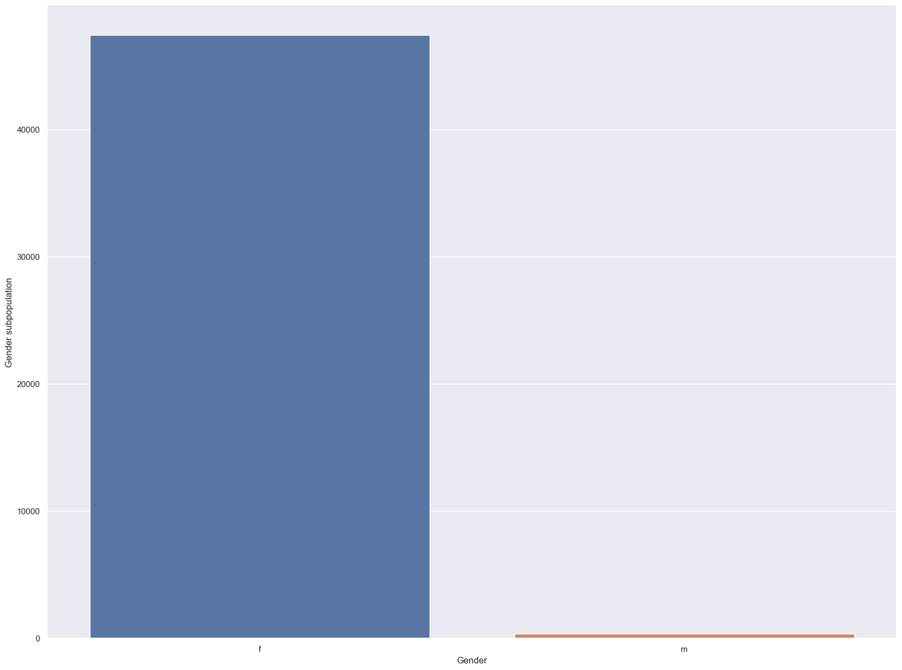
5. EXPLORATORY DATA ANALYSIS Univariate : Target_Gender
Observations
The Female gender significantly outperform the male gender meaning the female bought more of the Jewelry than the male.

Slide 10
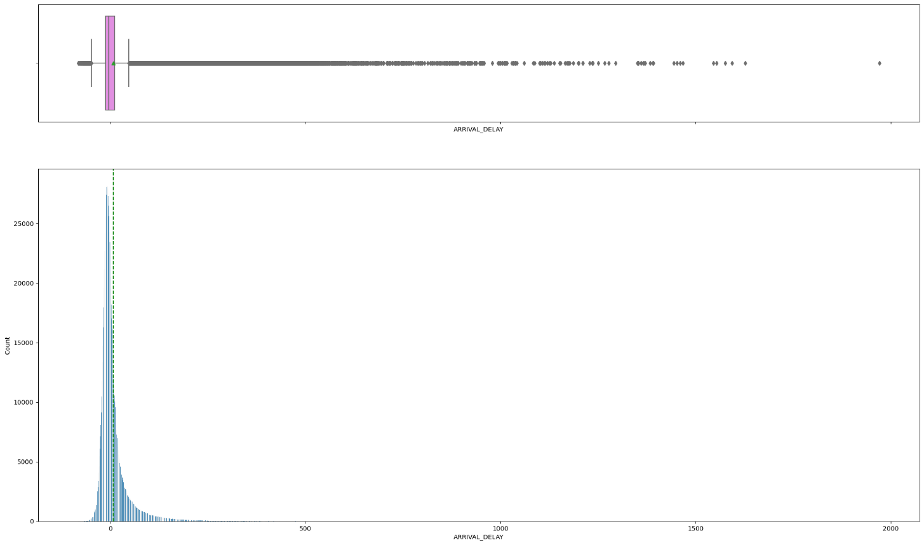
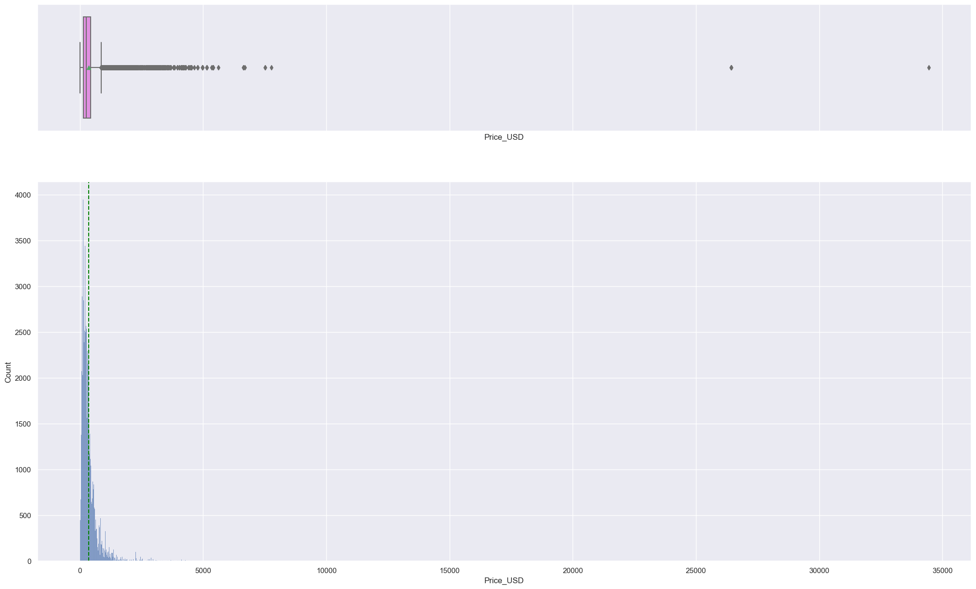
Exploratory Data Analysis – Price_USD
The outliers in the "Price_USD" indicate incorrect data entries also it could represent rare, customized or high value pieces

Slide 11
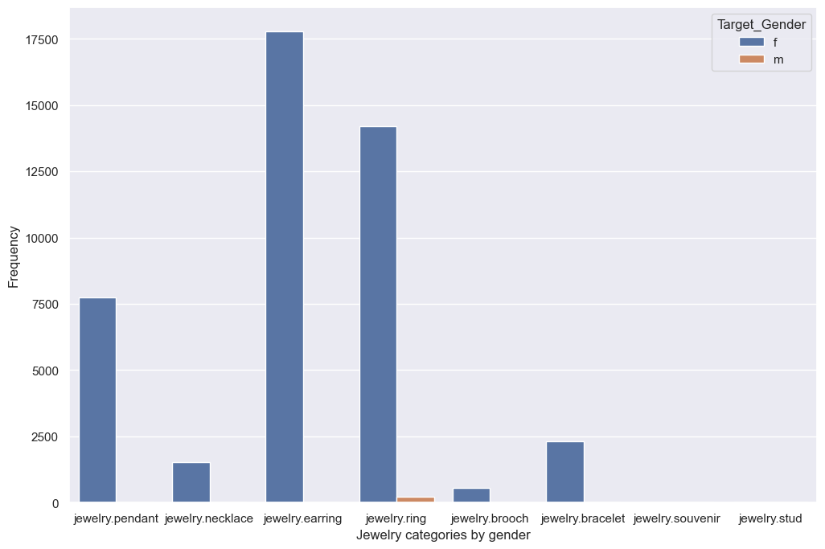
Exploratory Data Analysis –Jewelry Categories by Gender
*The Rings and earrings are more frequent with women, this aligns with traditional jewelry trends .
The distribution of the income is highly skewed to t

Slide 12
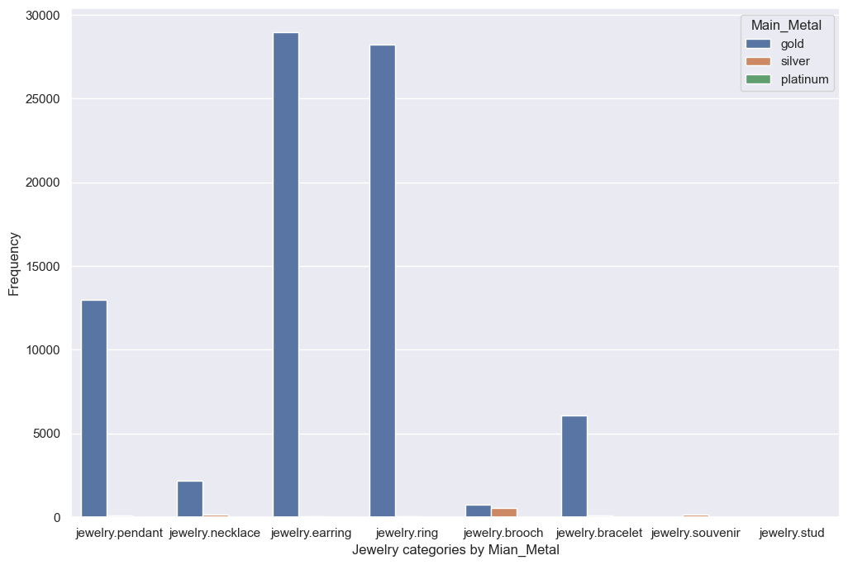
Exploratory Data Analysis – Jewelry categories by Main Metal
Observation
The following jewelry in the other earring, ring pendant are most popular amongst male and female while the Brooch, souvenir indicate niche market

Slide 13
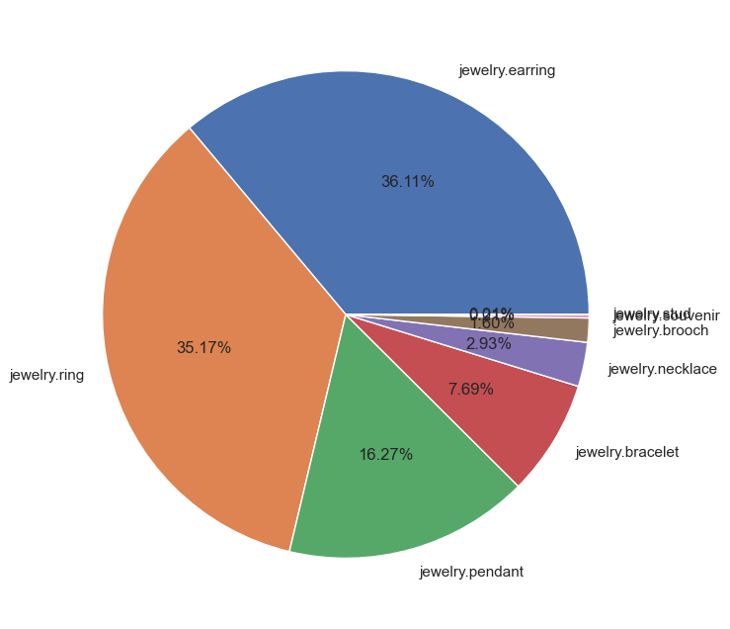
Exploratory Data Analysis- Jewelry categories
Observation
Observation
43.96% of the customers use fiber optic
I
Observation
Dominant Categories – Jewery_ring, Jewelry_earring and Jewelry_pendant categories take up a significantly larger portion of the pie chart, indicating they are the most frequently occurring in the dataset.
Less Popular Categories – A few categories like Jewelry_sourvenir, Jewelry_necklace and Jewelry_brooch are in much smaller proportions, showing they are less common.
Category Variety – The dataset contains multiple jewelry types, showing a diverse range of products.
Market Trends – The dominant jewelries, suggests they are more in demand compared to other types of jewelry.
c [ ]:

Slide 14
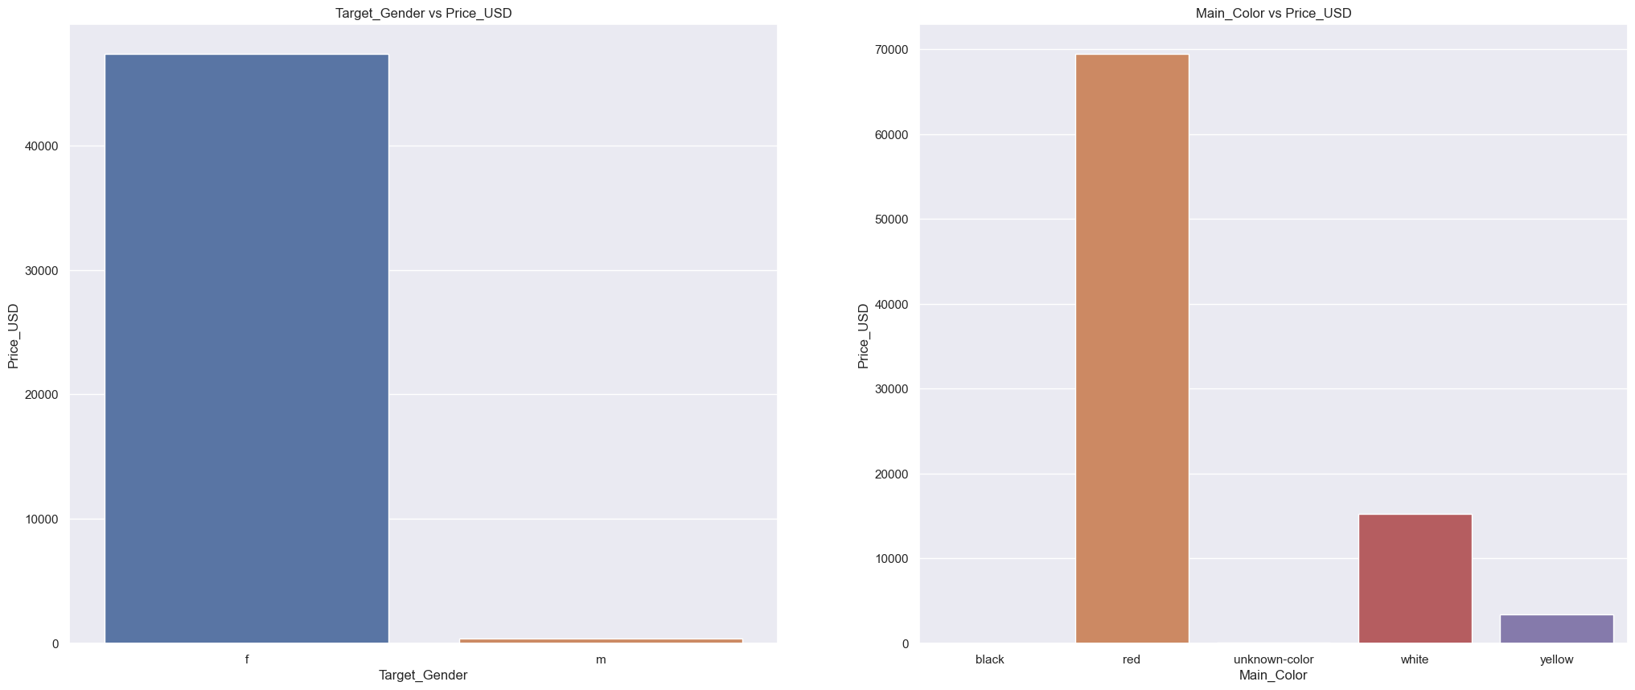
Exploratory Data Analysis –
Target_Gender vs Price_USD")
:
It seems more jewelry items are targeted towards the female than the Male. Also it means more jewelry items are available and sold in Red.

Slide 15
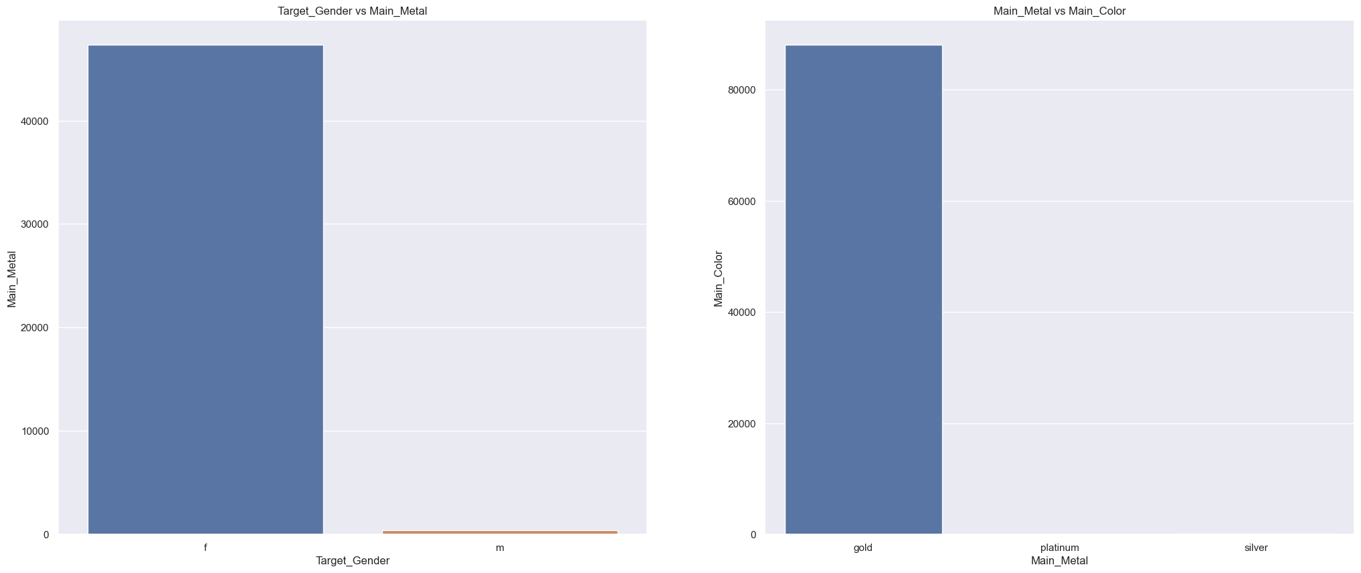
Exploratory Data Analysis –
The female purchased more accross the various metal and also the gold has the more colors than the other metals.Both visualization indicate that the Gold is the most used metal for women

Slide 16
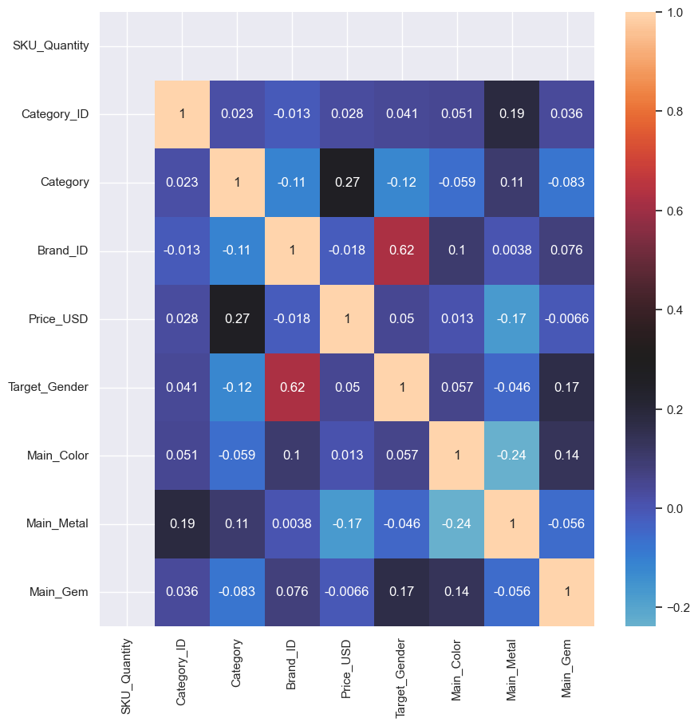
Exploratory Data Analysis –Heatmap-Correlation matrix
The price_USD has a moderate correlation with category and Target_Gender but weak correlation with Main_Gem and Brand_ID, indicating that some features influence pricing trends. But generally correlations are very weak suggesting a diverse dataset with relatively independent attributes.

Slide 17
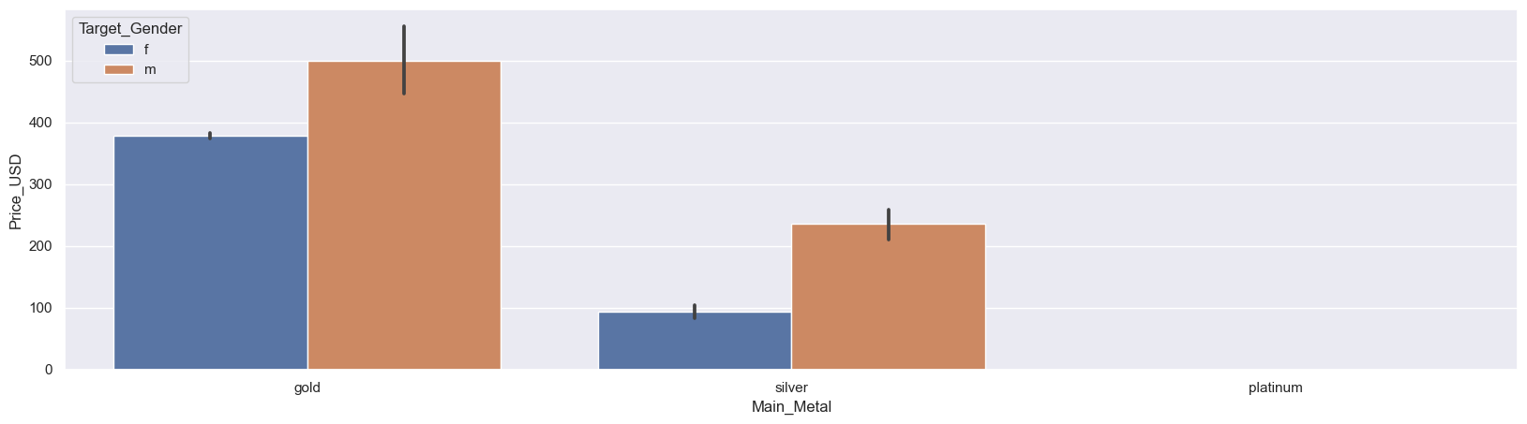
Exploratory Data Analysis –Multiariate analysis

Slide 18
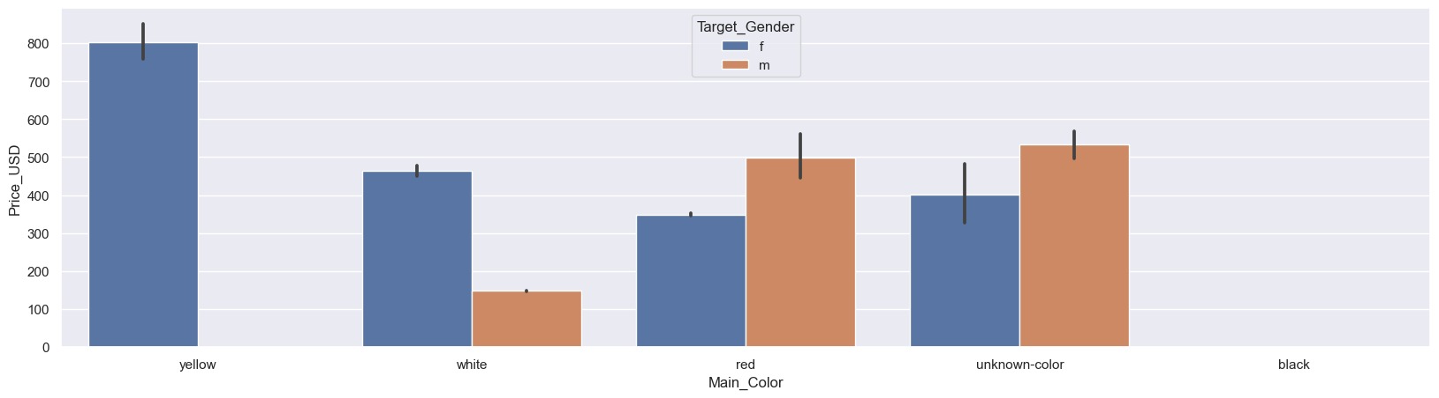
Exploratory Data Analysis- Price_USD/Target_Gender/Main_Color
The Female Gender preferred the yellow than the rest colors hence the price was significantly higher than the others

Slide 19
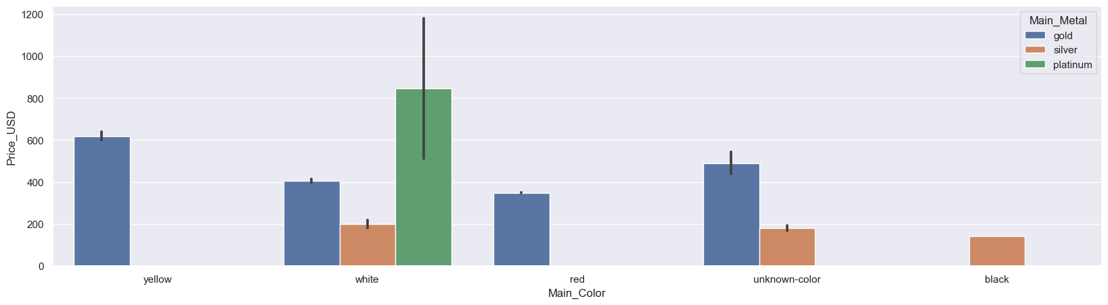
Exploratory Data Analysis- Price_USD VS Main_color vs Main_Metal

Slide 20
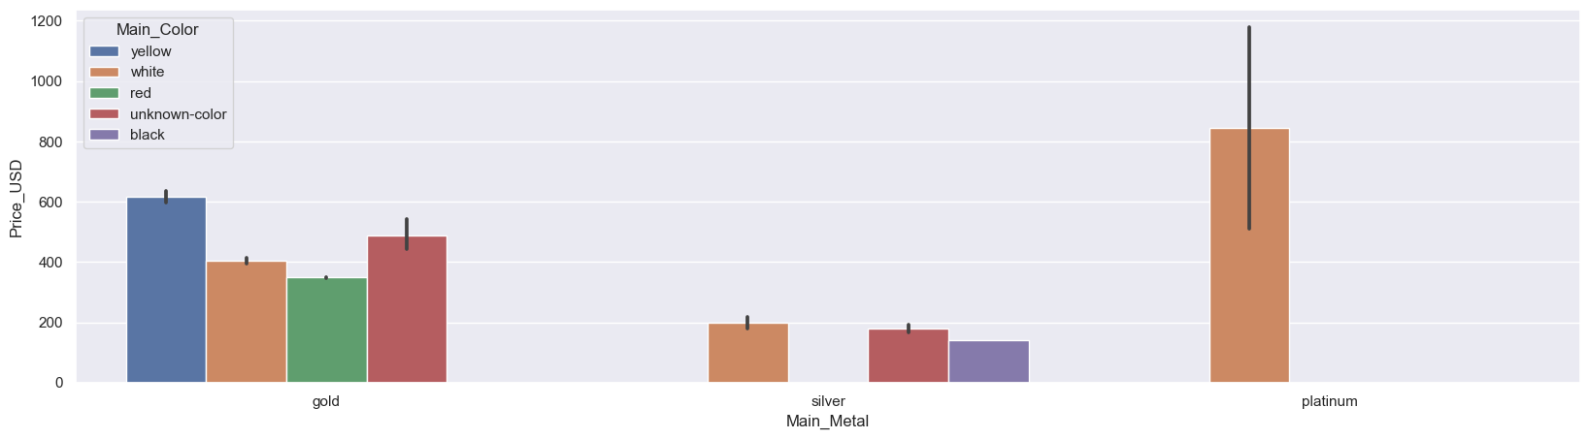
Exploratory Data Analysis – Price_USD VS Main_Metal Vs Main_color
Gold has four different colors meaning there are various options for gold than the rest Metals. Obviously more money to be made from the sales of Gold. The colors of the gold are linked to high prices. The Rare colors (black, blue) may indicate designer or specialty jewelry.

Slide 21
STEPS FOR MACHINE LEARNING
The project involved implementing several machine learning algorithms, including LinearRegression, AdaBoostRegressor, XGBRegressor, CatBoostRegressur,LightgbmRegressor and svr. Each algorithm was evaluated based on key performance metrics such as RMSE and R2.
Key Insights:
The models demonstrated low accuracy across the board, CatBoostRegression model being the best model with R2 of 32% followed XGBRegressor of 23% . Linear Regression performed the least with Train r2 of 6.9% and RMSE of 430 and359-test.

Slide 22
MODEL EVALUATION SUMMARY
CatBoost and XGB Regression are the top-performing models though low
Lightgbm Regression also performs well but slightly below Catboost and XGB Classifier.
.

Slide 23
7. OVERALL INTERPRETATION
●
Overall Interpretation:
The R-squared value indicates that the model captures a moderate portion of the variability in Price_USD, but there is room for improvement.
Further analysis and potential model improvements may be explored to enhance predictive performance and address the remaining variability in Price_USD.

Slide 24
8. KEY INSIGHT
CatBoostRegressor is the best model as it supports categorical features and works well with missing data
CatBoost performance is based on RMSE against the other models which is quite lower meaning the model’s prediction is slightly better though there is still large erros.
The predicted values of all the models are significantly deviating from the actual values. This means the models are making large errots, leading tp poor predictive performance

Slide 25
1. Platinum which is a high-end product have little or no transaction, therefore, the need for market push for premium buyers.
RECOMMENDATIONS
2.Optimize Product Pricing Using Demand Elasticity
3. For inelastic products (high-end jewelry) → Increase prices to maximize revenue.
4.For elastic products (mass-market items) → Use discounts & promotions strategically.
5. Implement tiered pricing models based on customer segments.
6. Offer exclusive experiences & loyalty programs for high-end buyers.
7. Optimize discounts & promotions for budget-conscious segments.

Slide 26

Thank you
16
Proprietary content. © Great Learning. All Rights Reserved. Unauthorized use or distribution prohibited.

